Slide 1

An Overview to Programming

Slide 2
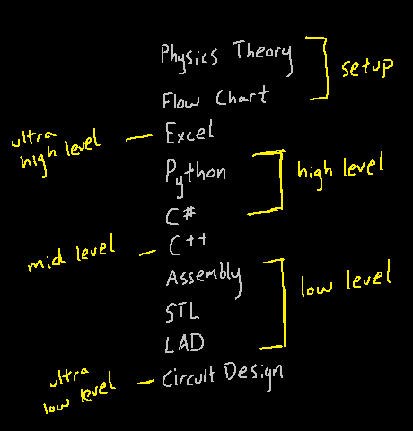
Overview

Slide 3
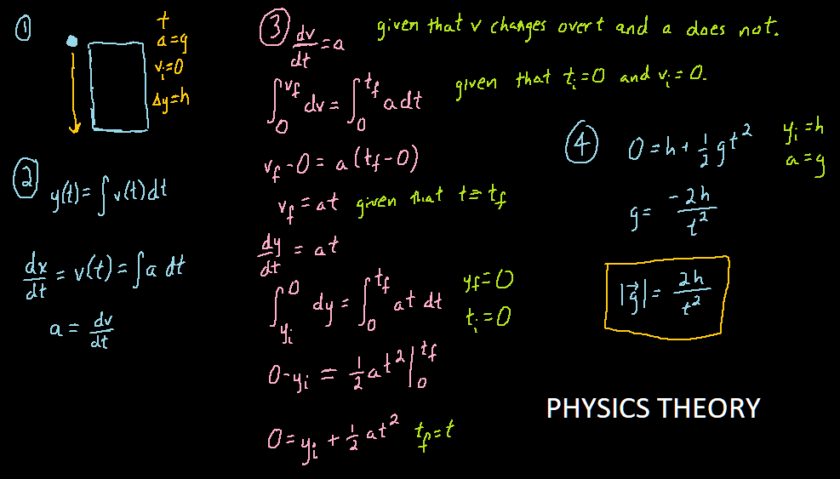

Slide 4
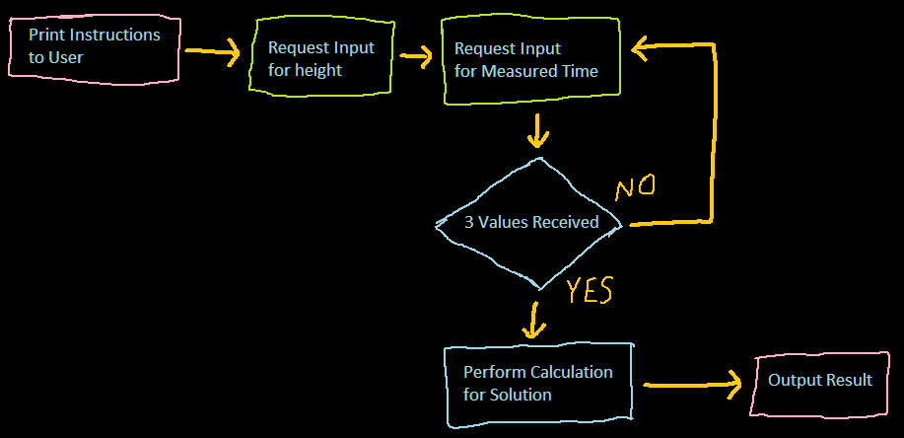
Flow Chart

Slide 5


Spreadsheet

Slide 6
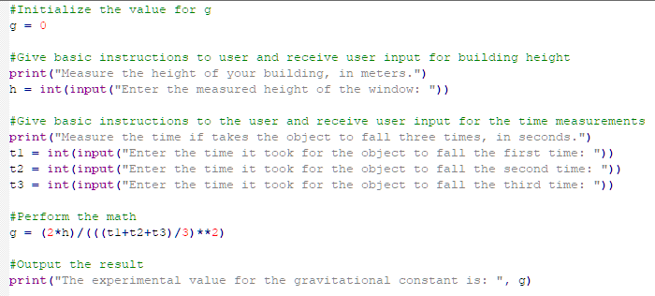
Python 01

Slide 7
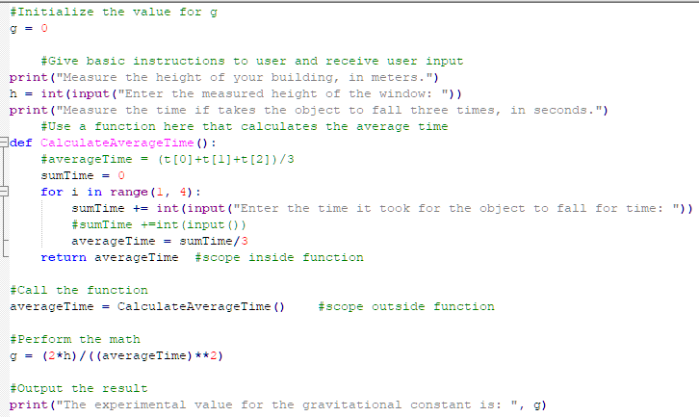
Python 02

Slide 8
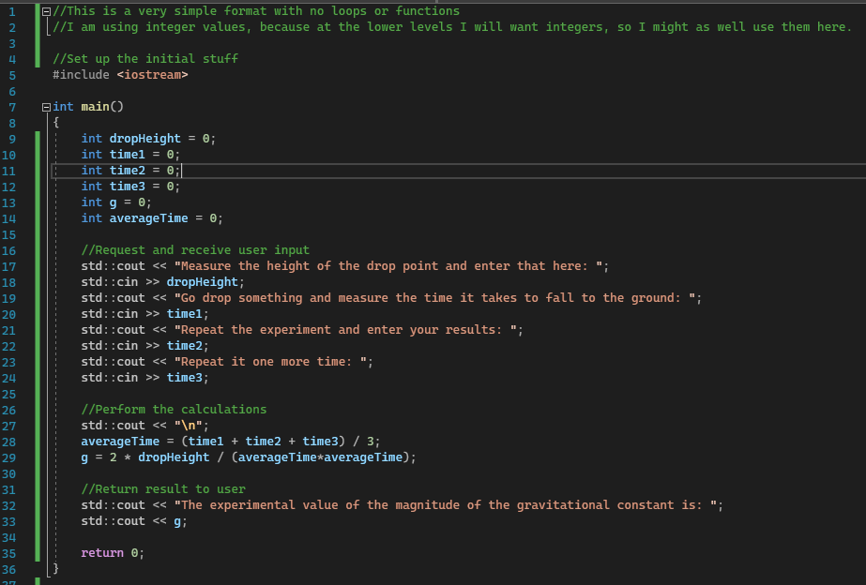
C++

Slide 9
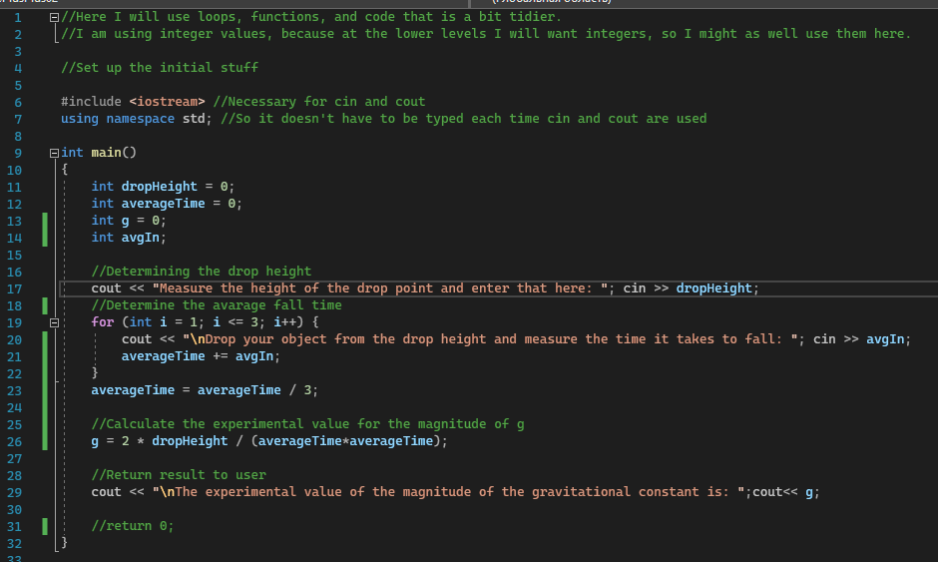
C++
C++

Slide 10
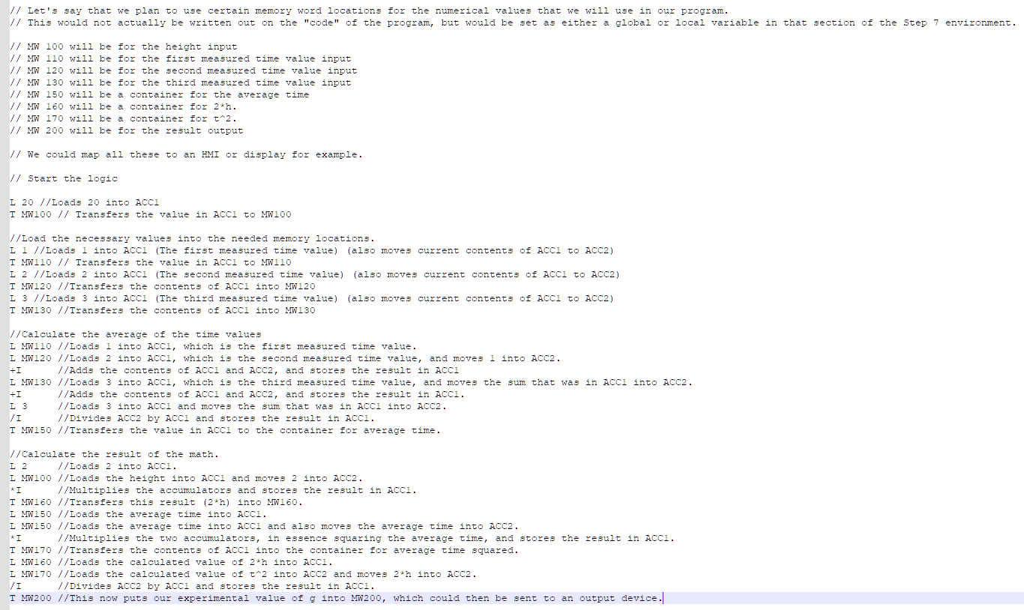
STL
STL (Statement List)
I would love to show this in Step 7,
But I could easily show it in Notepad++.

Slide 11
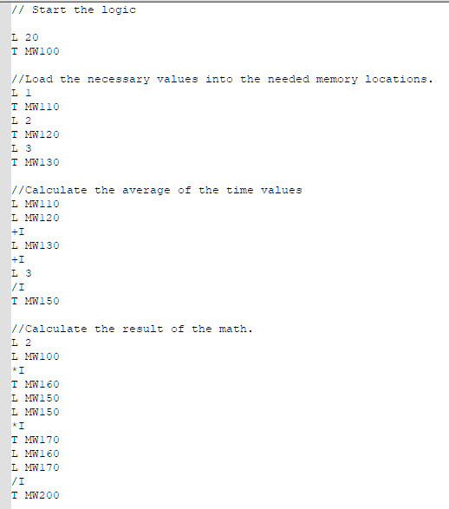
STL

Slide 12
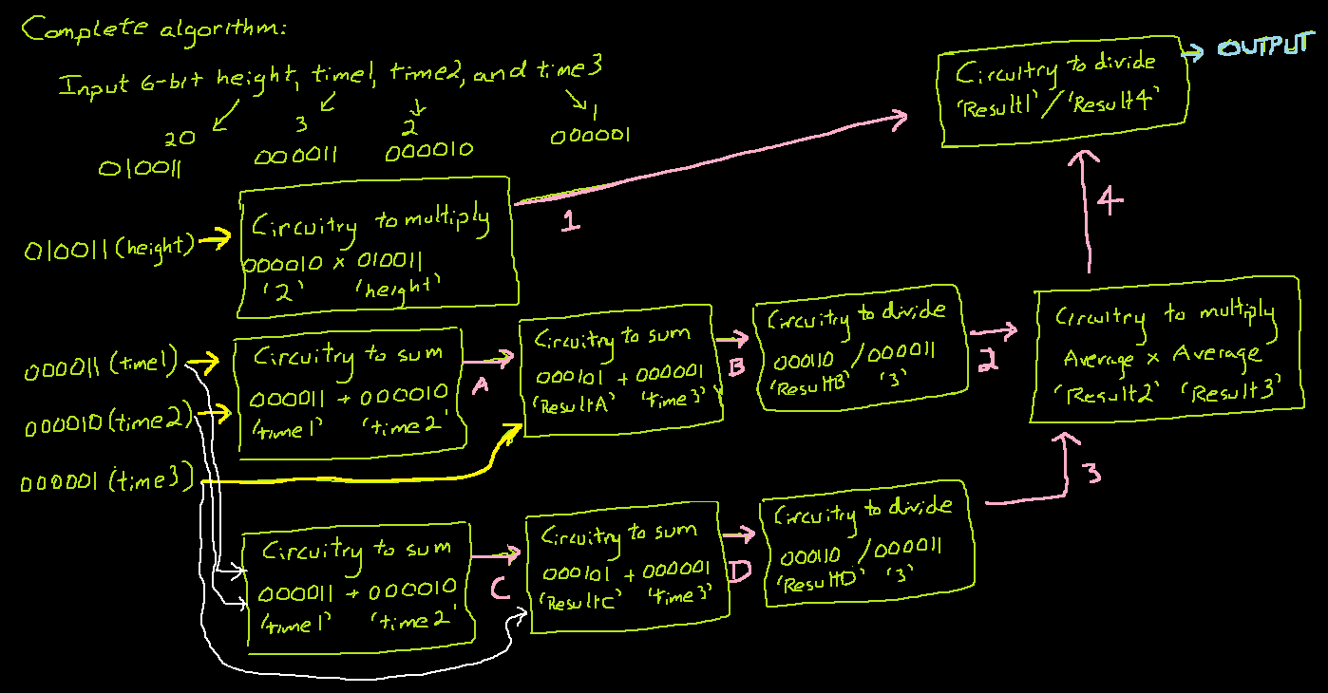
Circuit Design
Circuit Design

Slide 13
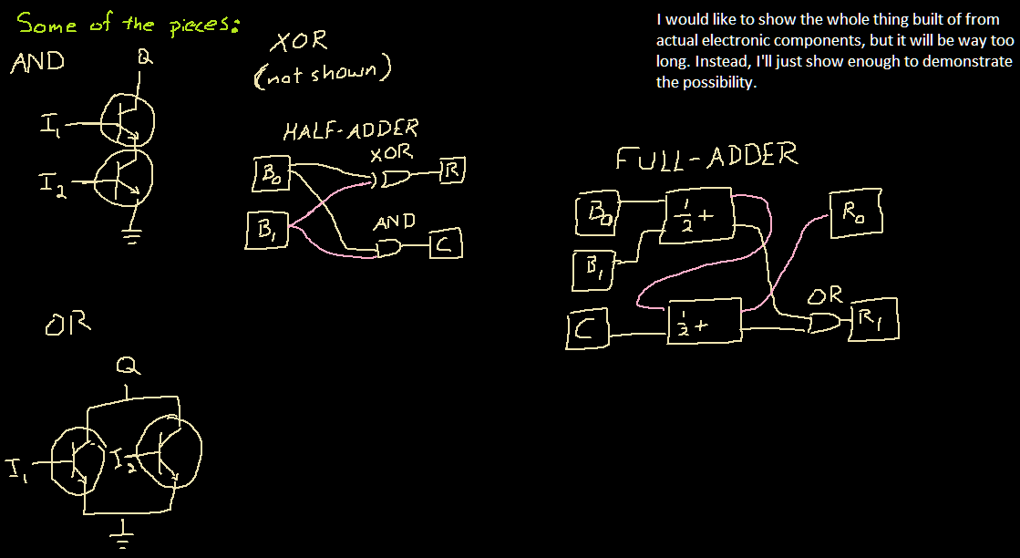

Slide 14
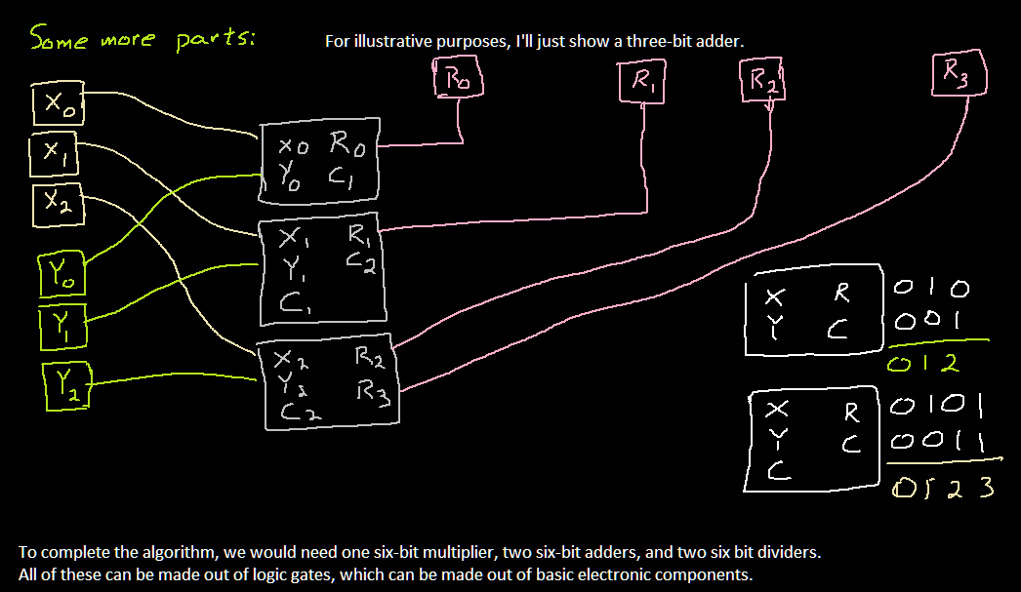

Slide 15
Connections

